Slide 1
Financial Forecasting With Neural Networks
Terrance West

Slide 2
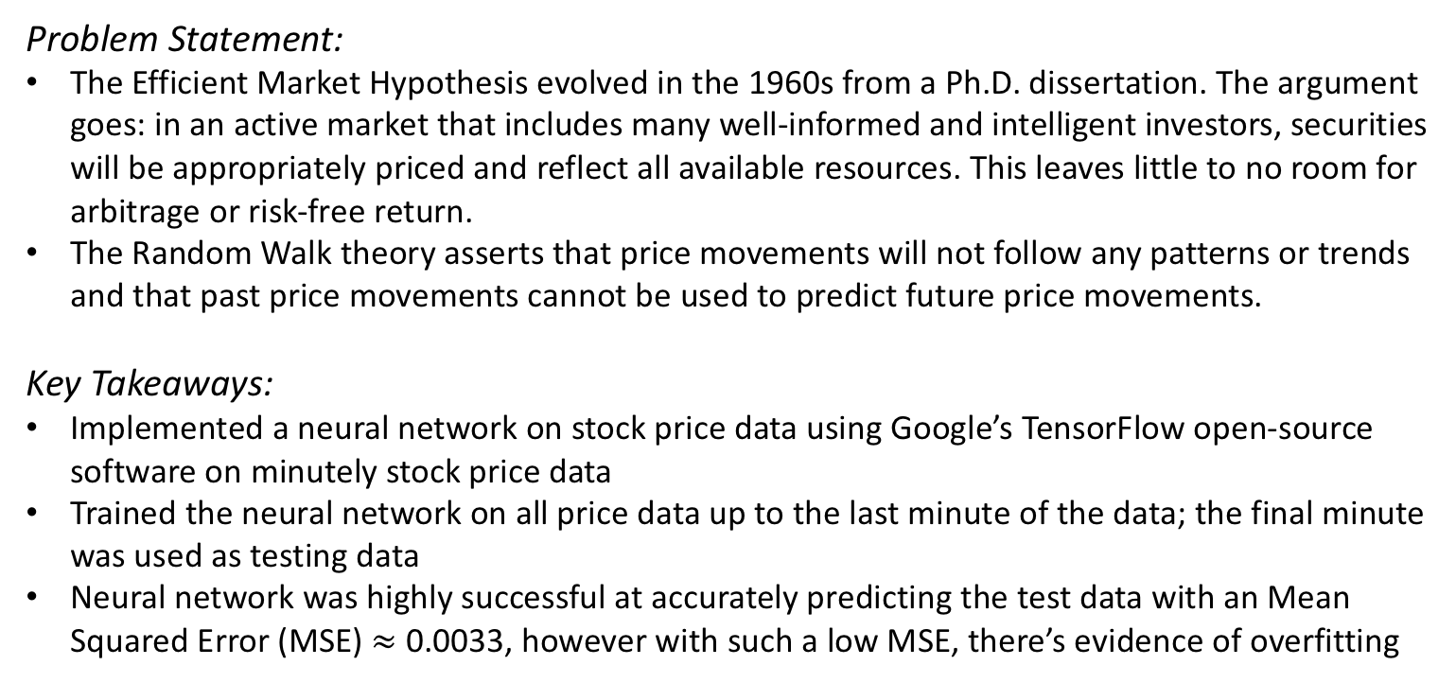
Executive Summary
Problem Statement:
The Efficient Market Hypothesis evolved in the 1960s from a Ph.D. dissertation. The argument goes: in an active market that includes many well-informed and intelligent investors, securities will be appropriately priced and reflect all available resources. This leaves little to no room for arbitrage or risk-free return.
The Random Walk theory asserts that price movements will not follow any patterns or trends and that past price movements cannot be used to predict future price movements.
Key Takeaways:
Implemented a neural network on stock price data using Google’s TensorFlow open-source software on minutely stock price data
Trained the neural network on all price data up to the last minute of the data; the final minute was used as testing data
Neural network was highly successful at accurately predicting the test data with an Mean Squared Error (MSE) $≈$ 0.0033, however with such a low MSE, there’s evidence of overfitting

Slide 3
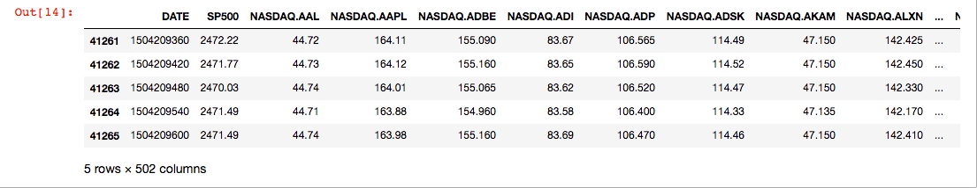
S&P 500 Financial Dataset
STATWORX put together a data set of minutely prices for each S&P 500 constituent as well as the S&P 500 index from the Google Finance API
There’s 41,266 minutes of data for each S&P 500 constituent as well as the index itself for a total of 20,715,532 total data points
The data ranges from April – July 2017

Slide 4
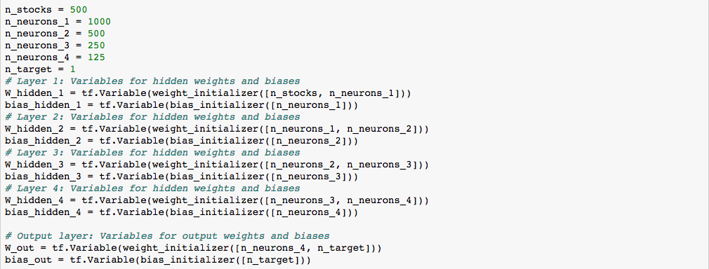
Model Architecture Parameters

Slide 5
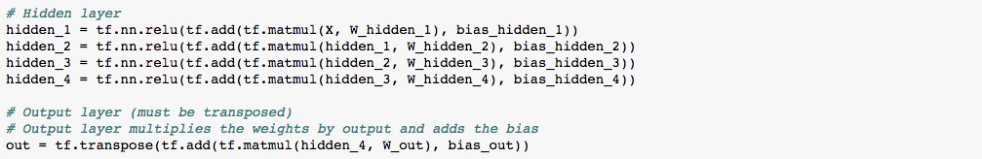
Hidden Layers

